Slide 1
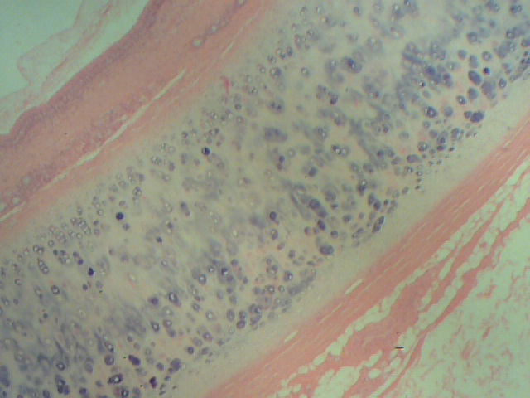
Hyaline cartilage, trachea
perichondrium

Slide 2
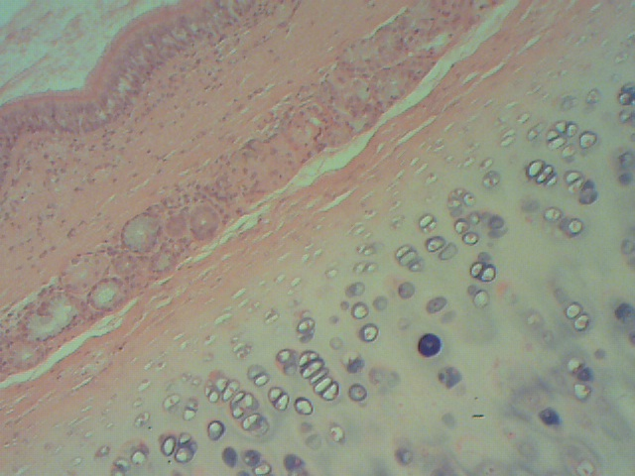
Hyaline cartilage, perichonderium trachea

Slide 3
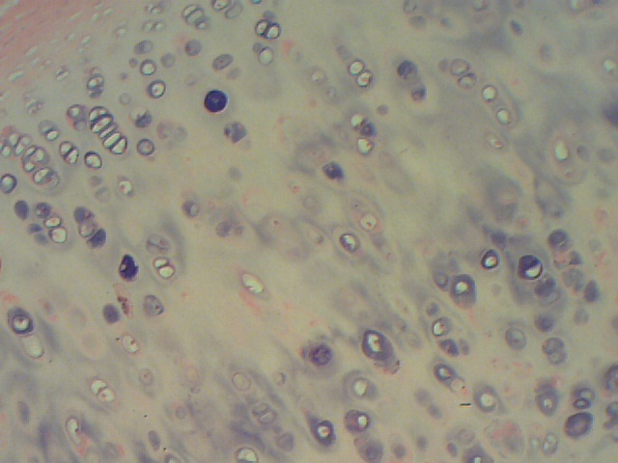
Hyaline cartilage, trachea

Slide 4
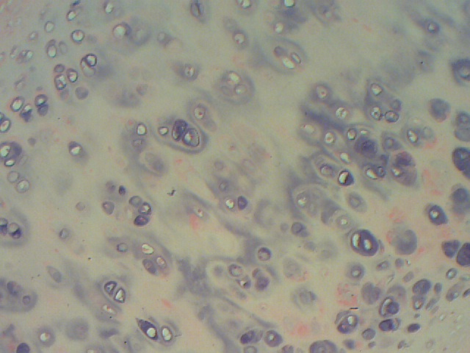
Hyaline cartilage , Isogenous group , trachea

Slide 5
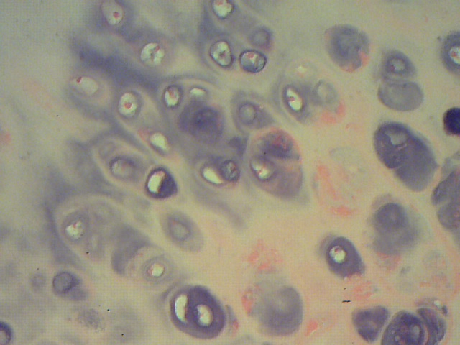
Hyaline cartilage , Isogenous group , trachea
Isogenous group
Isogenous group

Slide 6
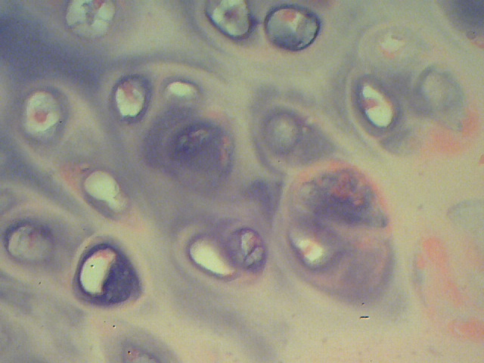
Hyaline cartilage , Isogenous group , trachea

Slide 7
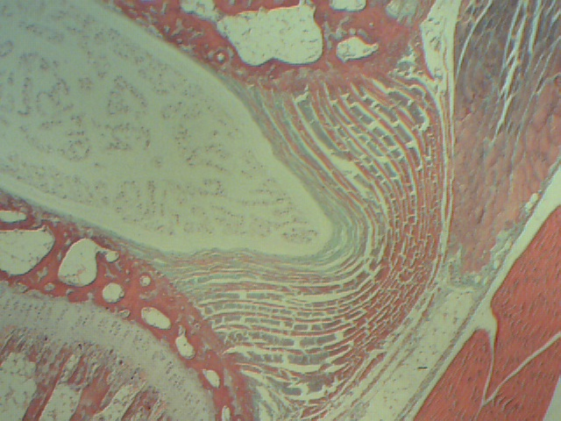
Joint of invertebral disc

Slide 8
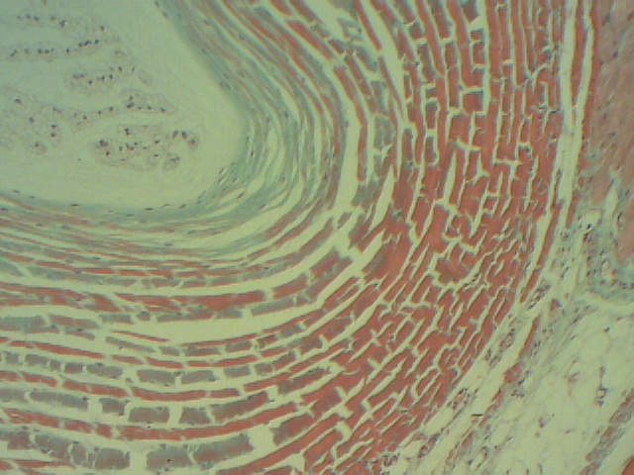
Fibro cartilage, invertebral disc
Collagen Fiber type 1

Slide 9
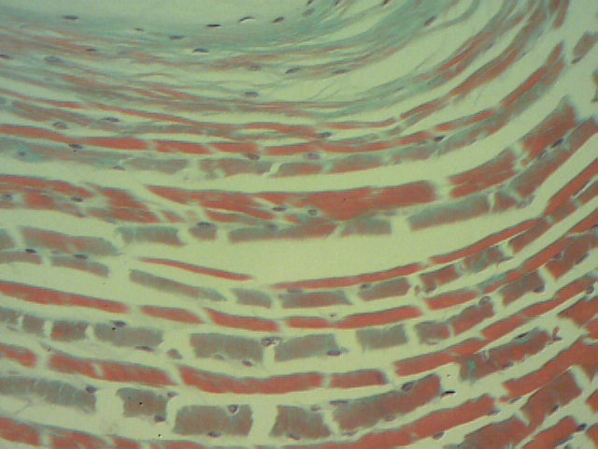
Fibro cartilage, invertebral disc
chondrocyte

Slide 10
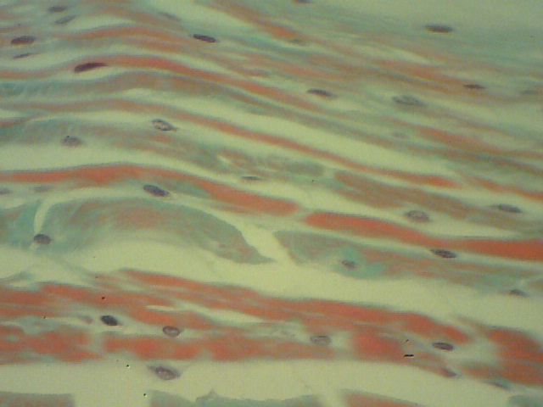
Fibro cartilage, invertebral disc, chondrocytes within collagenous fibers
chondrocyte
Collagen fiber
chondrocyte

